Slide 1
Taking TNFD to your board
Template materials
Sep 2024

Slide 2
How to use this deck
This deck demonstrates why the Task Force on Nature-related Financial Disclosures (TNFD) is relevant to all Boards and how businesses can get started. It is for readers who have heard about TNFD but want to learn more about how it is relevant to their priorities.
It has been produced by the Green Finance Institute, which leads the TNFD UK consultation group, in collaboration with Chapter Zero.
If you are a Head of Sustainability preparing for a board discussion:
If you are a Non-Executive Director upskilling on nature:
Use Section 1 to identify which reasons to act on TNFD will resonate most with your board and extract key relevant evidence.
Use Section 2 to become familiar with how peers in the market are leveraging progress on climate, building the right skills across corporate functions and establishing governance structures for nature. Use as inspiration to develop an initial action plan on nature.
Use Section 3 to understand how the TNFD recommendations and guidance can help your business on this journey and what adopting the TNFD framework means.
Streamline and customise information by reducing or condensing critical details to keep the presentation engaging and to the point.
Use Section 1 to understand how nature and TNFD are relevant to your priorities as a board member.
Use Section 2 to understand how your business can equip itself to manage its nature risks and opportunities, access learning materials, and compare your current board structure with the example governance framework to understand the entry points for nature across your duties as a board member.
Use Section 3 to understand how the TNFD recommendations and guidance can help your business on this journey and what adopting the TNFD framework means.

Slide 3
Contents
Why are Boards acting on nature and TNFD?
How are businesses getting organised?
How can the TNFD framework help?

Slide 4
Why are Boards acting on nature and TNFD?
Deep dives to follow
Climate | Risk | Opportunity | Investors | Regulation | Peers
Nature is critical for companies to meet their climate goals. Nature is a key source of carbon sequestration as well as resilience to the impacts of climate change. Nature loss can also exacerbate physical climate risks. | Nature loss poses financial risks to businesses, such as supply chain disruptions, rising input prices, and regulatory costs. Directors' duties are evolving to include oversight of nature risks. | Shifting to nature-friendly practices can create new business opportunities, such as accessing new product markets, cutting production costs and enhancing brand value. | Investors are increasingly pressuring companies to disclose details of their nature strategies and risk management frameworks. | Mandatory disclosure requirements on nature are incoming or expected in several jurisdictions, as well as compliance markets to minimise and offset nature impacts. | Companies across all sectors are moving on TNFD creating competitive pressure to keep up with industry standards and avoid falling behind.
Natural ecosystems are expected to deliver a third of carbon sequestration required to meet 1.5°C-aligned climate goals. | More than half of global GDP is moderately to highly dependent on nature and $900bn in annual corporate turnover is at risk because of deforestation-linked risks. UK GDP could take a 6% hit by 2030 due to chronic nature loss alone. | The nature transition could bring over $10 trillion in business opportunity and 395 million jobs globally by 2030. | More than 200 global institutional investors are working together to engage with investees on nature through PRI Spring and Nature Action 100 initiatives. | 4 jurisdictions have announced mandatory disclosure requirements on nature including the EU and China. The UK is aligning with ISSB which is now working on a potential new nature standard. | More than 400 adopters globally and over 60 UK organisations have committed to report on TNFD for FY2025.

Slide 5
Nature is a critical tool for companies to meet their climate goals
The degradation of nature exacerbates the impacts of physical climate risk, leading to the compounding and acceleration of climate change impacts
Sequestration of carbon emissions
Nature-based Solutions (NbS) are expected to account for roughly 1/3 of economically feasible sequestration of anthropogenic CO₂ over the next 30 years
Abatement of carbon emissions
Many of the drivers of nature loss are also significant sources of CO₂ emissions. Tackling nature loss can also help to abate emissions
Adaptation to future climate effects
Nature restoration projects improve flood defences, reduce desertification, improve soil health and recharge groundwater supplies
^{How does nature contribute?}
How can companies use nature to meet climate goals?
Nature-based solutions
Investing in nature restoration projects or purchasing carbon credits from nature-based projects can contribute to sequestration goals
Deforestation
Measures to tackle deforestation e.g. risk assessments, supplier due diligence, certification, contribute to CO₂ abatement
Circular economy
Adoption of circular economy principles reduces both CO₂ emissions and nature impacts by eliminating waste and pollution, circulating products and materials, and regenerating nature
Water quality and quantity
For businesses dependent on freshwater, nature restoration projects can tackle the impacts of drought and increased weather variability on the stability of water sources
Disaster protection
For businesses exposed to increased flood risk, nature restoration projects and soil health improvements can provide improved drainage and protect physical assets
^{Example}
Unilever invests in reforestation through the LEAF coalition (alongside other corporates such as Amazon, EY and BlackRock) as part of its carbon sequestration approach. The coalition will mobilise $1 bn to protect tropical forests
12% of Schneider’s revenue is generated through the sale of products made with recycled materials, leasing, pay-per-use and take back schemes, contributing to the reuse of rare earth materials, reducing the need for further extraction of resources and reducing CO₂ emissions
United Utilities invests in natural flood management practices such as restoring river bends and creation of buffers, enabling continued functioning of water distribution and drainage at times of high flood risk
Source: UNEP, Why nature holds the key to meeting climate goals; Our World in Data, Annual CO2 emissions from land use change; UNEP, Ecosystem-based adaptation; LEAF Coalition; Schneider; United Utilities.

Slide 6
Nature loss creates material financial risks for business
Across 10 real-life corporate case studies published by Bloomberg NEF, nature loss caused $80 billion in financial loss, including reductions in market cap, credit rating downgrades, lost revenues, legal costs and fines
Businesses are exposed to transition risks through their impacts on nature…
…and physical risks through their dependencies on nature
Risk type
Policy
Liability
Market
Reputation
Acute
Chronic
Business impact example
$165,000 in penalties
Water treatment infringements resulting in invasive species release
$10.5 bn in legal liabilities
Release of ‘forever chemicals’ into US waterways
Share price decline
Media reports tying operations to a protected Indonesian national park
$20 bn in lost market value
Criticism of deforestation prevented listing in the US
£77 million in losses
Loss of sales and brand damage from avian influenza linked to poor biosecurity
3% share price fall, $5.7 bn facility delayed
Berlin gigafactory delayed due to extraction of groundwater
Financial impact
Opex
Opex
Valuation
Valuation
Revenue
Valuation
Nature risks are affecting your business, suppliers, clients, competitors, customers, and/or employees
Note: TNFD also identifies technology risk as a transition risk.
Source: BNEF article providing 10 case studies that highlight the financial costs of nature-related risk

Slide 7
Nature loss also creates systemic risks for the macroeconomy
Central banks and financial supervisors are recognising nature loss as a material risk to macroeconomic financial stability
“[Nature] risks may have profound effects on both the real economy and […] on the financial system through […] credit risks, market risks and operational risks, and indeed with potential feedback to the real economy again.”
“As central banks and supervisors, we have every reason to be concerned because it’s an illusion to think we can preserve financial stability if this [nature] degradation continues.”
“Damage to the natural environment is slowing the UK economy and could lead to an estimated 12% reduction to GDP in the years ahead – larger than the hit to GDP from the global financial crisis or Covid-19.”
Financial Stability Board, July 2024
Klass Knot, DNB President, FSB Chair, ECB Governing Council, September 2023
Green Finance Institute, April 2024
Source: Stocktake on Nature-related risk, FSB; Assessing materiality of Nature-related financial risks for the UK, GFI.

Slide 8
Yet there are commercial opportunities for businesses that adapt to the nature transition
Opportunity
Description
Company example
The World Economic Forum highlights that shifting to nature-positive practices could unlock $10.1 trillion and 395 million jobs by 2030.
New product development
New products with lower impacts on nature relative to traditional alternatives are gaining market share
Bioplastic is a fast-growing sustainable alternative to traditional plastic packaging. The market size was valued at $7.49 billion in 2023 and is expected to grow 29% by 2032. Sway, a bioplastic manufacturer producing alternatives from seaweed, has raised over $14m of funding since 2020
Food, land & ocean use
Infrastructure & built environment
Energy & extractives
Customer purchasing decisions
Consumers are increasingly integrating a company’s nature impacts into their purchase decisions
Nestlé’s response to Greenpeace’s 2018 palm oil campaign was to move beyond competitor pledges and commit to removing deforestation from their entire value chain
Cost savings
Nature-friendly business models often use less resources and reduce input costs
Tetra Pak have committed to reducing water withdrawal by 35% by 2030, which will reduce both operational costs and pressure on local water resources
Source: WEF report on the future of nature and business

Slide 9
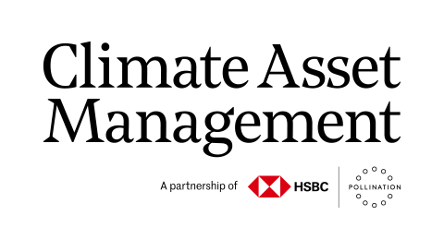
New products are emerging to finance the transition
Financing avoidance and reduction of nature harms
Financing conservation and restoration of nature
Manufacturing - circular economy, bio-degradable packaging
Construction – use of sustainable materials
Food and retail – regenerative agriculture
Electricity – improvements in water efficiency
Mining – pollutant management, land reclamation
Reforestation and afforestation
Protection, conservation and rewilding
Peatland and wetland restoration
Marine and freshwater conservation
Seagrass meadow restoration
Natura&co with support from Morgan Stanley issued a $1bn sustainability-linked bond with performance targets tied to increased use of post-consumer recycled packaging, reducing the need for extraction of virgin materials
Bank of America issued a $500mn deal that lowers Gabon’s national debt interest rate and extends repayment times to unlock spending on marine conservation
Barclays issued a loan to Cairn Homes with terms of finance linked to performance against the UK’s Biodiversity Net Gain (BNG) metric alongside reduction in scopes 1-3 emissions and employment of young people
Tesco suppliers are offered preferential financing rates from Santander when investing into changes such as adoption of regenerative farming practices that support the achievement of Tesco’s scope 3 emission targets
Climate Asset Management, a joint venture between HSBC and Pollination, has raised $1 billion AUM and published a TNFD report. Its natural capital strategy aims to deliver commercial returns while restoring and protecting natural landscapes
Federated Hermes have partnered with Finance Earth to launch a fund that accelerates recovery of nature in the UK helping deliver against the UK’s nature targets such as protecting 30% of land by 2030

Slide 10
Investors are asking investees how they are tackling nature
Investors are issuing guidance, policies and letters to boards on their expectations on nature. Over 200 institutional investors, representing over $28 trillion in AUM are driving coordinated engagement through groups such as Nature Action 100 and the PRI Spring Initiative
“We encourage companies with a material impact and reliance on biodiversity and natural capital to put in place effective mitigation strategies within relevant timelines […] insufficient improvements in biodiversity-related strategy and risk management may lead to a dissenting vote cast against the Management (including by supporting biodiversity-related shareholder resolutions) or the Board.”
Corporate governance and voting policy, 2024
“We are encouraging these exchanges (Stock Exchange of Hong Kong (HKEX), Singapore Stock Exchange (SGX), Bursa Malaysia and Stock Exchange of Thailand (SET)) to align with the targets and goals of the Kunming Montreal Global Biodiversity Framework and to set clear recommendations within disclosure expectations and listing rules during 2025.”
LGIM Q2 engagement report, 2024
“We would expect and recommend the investee companies which we engage to demonstrate transparent disclosure, reporting regularly on biodiversity and endorsing the TNFD.”
Global investors biodiversity policy statement, 2023
“We expect all companies to begin reporting […] against the TNFD framework in 2023. In preparation […] companies should undertake […] LEAP.”
Annual letter to company chairpersons from Mark Versey, Aviva CEO
“We may be exposed to portfolio risks and lost investment opportunities as biodiversity and ecosystems become degraded […] over time externalities from unsustainable use of natural ecosystems may affect [portfolio] long-term performance.”
Expectations of companies
Nature Action 100 investor expectations
Ambition: Public commitment to minimise contributions to nature loss, restore ecosystems throughout value chain by 2030
Assessment: Public disclosure of nature-related dependencies, impacts, risks and opportunities
Targets: Set time-bound, science-based targets and disclose annual progress against them
Implementation: Develop plan on how to achieve targets
Governance: Establish Board oversight and disclose management's role
Engagement: Engage with external parties throughout value chain
Source: Nature Action 100, PRI Spring Initiative

Slide 11
Regulators are moving towards mandatory disclosure and other requirements to improve nature outcomes
UK
European Union
Other jurisdictions
The UK’s forthcoming Sustainability Disclosure Requirement (SDR) is aligned with ISSB’s S1 and S2 standards
With the framework in place to do so, the UK Government is expected to assess the suitability of any new ISSB standards (such as that for nature) for use within SDR
The ISSB’s next area of focus is “Biodiversity, Ecosystems and Ecosystem Services” (nature) which will heavily draw from the TNFD framework
Biodiversity Net Gain (BNG) is mandatory for all new UK developments, requiring a 10% uplift in biodiversity against the pre-development baseline
Nutrient Neutrality regulation requires that new developments must not increase overall nutrient load (nitrogen and phosphorous pollution) on water bodies
Corporate Sustainability Reporting Directive (CSRD) requires mandatory disclosures on nature. CSRD incorporates TNFD’s four disclosure pillars and recommends the LEAP approach is used for reporters’ double materiality assessments. EFRAG has published a mapping between CSRD and TNFD to support companies in producing joint CSRD-TNFD reports
Corporate Sustainability Due Diligence Directive (CSDDD) creates a legal duty for companies to identify and address their impacts on nature
EU Deforestation Regulation (EUDR) requires companies to ensure all products and services sold in EU are deforestation-free
Waste Framework Directive introduces a ‘polluter pays principle’ as well as ‘extended producer responsibility’
Critical Raw Materials Act (CRM Act) will diversity the EU’s imports to reduce strategic dependencies. Private operators will have to investigate potential for recovery of critical raw materials from extractive waste
Mainland China’s three main stock exchanges introduced requirements on sustainability reporting covering nature and the Hong Kong Stock Exchange also introduced broad ESG requirements
The Indonesian Financial Services Authority (OKJ) requires listed companies and financial institutions to make sustainability disclosures including nature
Brazil, Costa Rica, Sri Lanka, Nigeria, Bangladesh, Turkey and Australia have all adopted ISSB standards on sustainability reporting
Countries including Colombia and Australia have introduced compliance markets for impacts on nature with the global value of compliance offsets estimated at $6 billion
The US Forest Act has support from US House and Senate which would be an equivalent to EUDR. Similarly, the UK government is preparing to implement a Forestry Risk Commodity Regulation (UKFRC) with similar objectives to EUDR
CSRD compliance will also fall on non-EU companies with significant activities in the EU
Mandatory disclosure requirements
Compliance markets for impacts
Risk management policies
Source: SDR implementation update; ISSB announcement on biodiversity; CSRD interoperability mapping; FSB report on nature-related financial risks; EU Waste Law; EU CRM Act; US Forest Act 2023; UK Forest Risk Commodity Regulation.

Slide 12
Financial supervisors are also moving on nature
Central banks and financial supervisors are increasingly recognising nature loss as a material risk to financial stability, undertaking nature stress tests and developing guidance for licensed financial institutions
All financial regulators in the UK (including the Financial Conduct Authority and Prudential Regulation Authority) are required under the Financial Services and Markets Act 2023 to utilise the tools at their disposal to support the achievement of the goals set out in the Environment Act with repercussions for noncompliance
The Bank of England is working with the UK Government (via Defra), as well as NGFS and TNFD to build a “clearer picture of the nature-related financial risks facing the UK”
The Financial Stability Board (FSB) is an international body that makes recommendations to preserve the stability of the global financial system
Published stocktake of global supervisor action on nature
Assessments: 17 central banks and financial supervisors have conducted or are conducting nature-related risk assessments, largely concluding that exposures to nature-related risks are material and recommending further assessment
Guidance: 5 financial supervisors across emerging and advanced economies have issued supervisory guidance for financial institutions on the management of nature-related risks (with many more exploring the case to develop guidance)
The Network of Central Banks and Supervisors for Greening the Financial System (NGFS) is a global group of financial supervisors working together on climate and nature issues
Considers nature loss as relevant to financial supervisors’ core mandate of financial stability
Published guidance for how central banks should approach nature
Developing integrated climate-nature scenarios for use by financial sector
Source: NGFS, Reports on nature-related risks, FSB, Stocktake on Nature-related risks, Speech by Sarah Breeden, The nature of risk

Slide 13
Peers are moving across every sector
Over 400 companies have committed to report on TNFD for FY25
11
Published UK TNFD reports
49
UK companies reporting on TNFD in 2025
17
SBTN pilot companies
(developing science-based targets for nature)
9
Nature strategies published and validated
(by the Now for Nature initiative)
Market service providers include professional and commercial services.
Source: list of TNFD adopters, STBN pilot update, Now for Nature strategies

Slide 14
Contents
Why are Boards acting on nature and TNFD?
How are businesses getting organised?
How can the TNFD framework help?

Slide 15
Businesses are building on climate, leveraging existing progress
Examples of how strategies for nature can build on existing work on climate
Data and skills
Impact measurement and target setting approach – similarities between methodologies for calculating climate (e.g. emissions) and nature impact Data requirements – repurposing of location data from physical climate risk assessments and existing disclosures (such as CDP, TCFD, CSRD), water and deforestation data Supply chain mapping – repurpose supply chain data and approximation techniques from scope 3 emissions accounting Legal & General is leveraging location data collected for disclosure of flood risk within TCFD reporting to assess exposure to nature risks
Client and supply chain engagement
Engagement frameworks – extension of existing questionnaires, due diligence frameworks and risk assessments for climate to include nature, platforms to collect client and supplier data Stakeholder groups – use of existing fora to test requirements and develop approach Federated Hermes is building on existing climate engagement frameworks, adding nature-related considerations and expectations
Governance and business strategy
Governance structures – existing climate governance arrangements can often be used for nature Transition planning – nature can be incorporated into existing climate transition plans following same structure, delivery programme etc. Risk management – risk escalation processes on climate can be used for nature United Utilities is combining nature and climate governance approaches where appropriate and using nature-based solutions within their net zero transition

Slide 16
Businesses are finding value in early work on TNFD
“Piloting the TNFD framework has been an important step in our ambition to mitigate negative impacts and contribute to the protection of nature and biodiversity. Using the LEAP approach has strengthened collaboration between business units and enabled us to advance knowledge within the organisation on nature and biodiversity. We encourage other organisations to take the LEAP and get started!”
Head of Group Sustainability of Danske Bank (Danish-based organisation, Commercial bank)
“Using the TNFD’s LEAP approach to explore nature-related risks and opportunities associated with infrastructure development has been a fascinating and insightful experience. We have, in particular, welcomed the opportunity to become more confident in using the various datasets that are so important within the LEAP approach.”
Senior ESG Advisor of AECOM (USA-based organisation, Engineering and Construction Services, and Professional and Commercial Services)
“In 2022, we used the TNFD LEAP (Locate, Evaluate, Assess and Prepare) methodology to conduct a materiality assessment that enabled us to deepen our understanding of GSK’s physical and transition risks and opportunities across each component of nature. We included an initial disclosure using the draft TNFD guidelines in our most recent annual report, with a particular focus on strategy, metrics and targets.”
Chief of Staff to the Chief Financial Officer of GSK (UK-based organisation, Biotechnology and Pharmaceuticals)

Slide 17
All corporate functions can develop expertise by getting started and leveraging publicly available resources
Function | Sustainability | Finance, audit and risk | Procurement | Strategy | Operations | Communications | Boards & Non-exec directors
Skills and knowledge | Nature risk assessment; Training on nature; Sustainable finance; Lifecycle assessments; Development and project management of nature strategy | Nature risk assessment; Nature-related data (geospatial, state of nature) assurance; Nature-related regulation (disclosure, compliance market, director duty) | Supplier due diligence and nature KPIs; Supply chain data collection; Supply chain insetting / knowledge of nature positive solutions | Scope new products; Market sizing; Consumer profiling on nature; Competitor analysis; Business resilience to nature risks; Cost cutting | Data infrastructure setup; Training on nature; Circular economy understanding; Nature risk management; Resilience planning | Credibility of claims / greenwashing; Policy / NGO stance on nature matters; Media outreach to subject matter leads; External comms; Nature reporting | Nature-related regulation (disclosure, compliance market, director duty); Nature strategy and policy
Activities to start with and build skills | Pilot risk assessment, develop new product ideas, develop training materials | Profile relevant regulation, pilot risk assessment | Explore approaches in industry fora, gauge supplier readiness | Profile potential nature products and peer action | Gap analysis of data needs and potential data sources | Research external peer comms on nature activities and policies | Use this deck to become familiar with how nature is relevant to the role of a Non-Executive Director, table initial board discussion with management
Useful resources | Example TNFD reports Getting started with TNFD The LEAP approach Tools catalogue | Legal views on nature-related litigation Risk and opportunity register | Guidance on value chains Discussion paper on proposed approach to value chains | Guidance for corporates on science-based targets for nature SBTN Nature materiality toolkit | Getting started with TNFD The LEAP approach | Guidance on engagement with Indigenous Peoples, Local Communities and affected stakeholders | Chapter Zero Nature-related Risks and Duties of Company Directors Biodiversity as a material financial risk – What board directors need to know? Company Directors and Nature Risk (English Law) Boards and nature – evolving landscape for director’s duties Competent Boards Climate and Nature Designation Program
 | TNFD in a box is a useful primer for all corporate functions

Slide 18
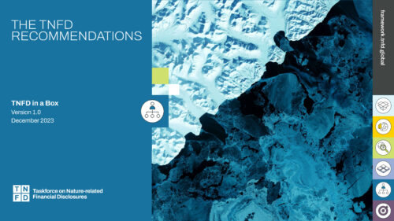
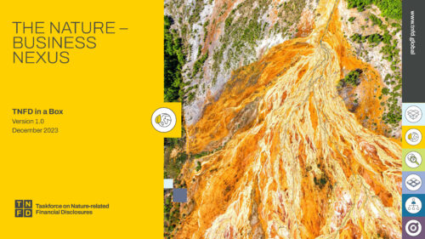
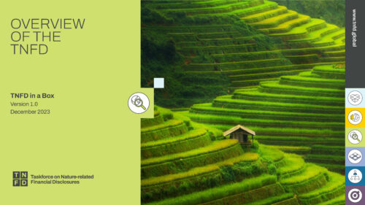
A wide range of Board capacity building materials are available
TNFD in a Box contains five modules and a high-level overview aimed specifically at Boards
Webinars and blog posts aimed at boards
Nature-related Risks and Duties of Company Directors
Biodiversity as a material financial risk – What board directors need to know?
Company Directors and Nature Risk (English Law)
Boards and nature – evolving landscape for director’s duties
Competent Boards Climate and Nature Designation Program
Module 3: The TNFD Recommendations
Covers the 4 pillars and each of the 14 recommended disclosures, using real-world examples.
Board level overview
A high-level summary of key elements tailored to boards.
Module 1 The Nature-Business Nexus
Covers the relationship between nature and business and provides the business case for acting on nature.
Module 4: The TNFD assessment approach (LEAP)
Walks through LEAP, the integrated approach developed by the TNFD to provide a structured way to identify and assess nature-related issues.
Module 2 Overview of the TNFD
Covers the Taskforce’s origin, mission, timeline and the reporting landscape the TNFD sits within.
Module 5: Metrics, Data, Scenarios and Engagement
Covers additional assessment guidance that supports identification, assessment and management of nature-related issues.
Source: TNFD in a Box.

Slide 19
Governance arrangements for nature should follow the same principles as for climate
P1
P2
P3
P4
P5
P6
P7
P8
Principle 1
Accountability
Be held accountable to shareholders for the long-term resilience of the company, including shifts in the business landscape that may create climate and nature risks and opportunities
Principle 2
Subject command
Ensure diverse composition to effectively debate and take decisions informed by an understanding of climate and nature risks and opportunities
Principle 3
Board structure
Integrate climate and nature
considerations into structure and committees to allow stewardship for long-term performance
Principle 4
Materiality assessment
Challenge management to assess materiality of climate and nature risks and opportunities on an ongoing basis, ensuring that responses are proportionate to materiality
Principle 5
Strategic integration
Integrate climate and nature considerations into investment planning and decision-making processes across the organisation
Principle 6
Incentivisation
Ensure executive incentives are aligned to promote long-term performance of the company, including climate and nature-related targets and indicators
Principle 7
Reporting & disclosure
Drive transparent disclosure of climate and nature risks, opportunities and strategic decisions to investors and regulators where relevant
Principle 8
Exchange
Maintain regular dialogues with peers, policy-makers and investors to keep abreast of climate and nature risks and opportunities
Assigns nature accountability with CEO
Delegates expertise to Group Environment Committee
Quarterly board meeting to consider natural capital as part of credit application
Assesses materiality using biodiversity driver database
Integrates nature considerations into product development and financial planning
Links renumeration and bonuses to nature targets
TNFD report available for use by regulators and investors
Comprehensive stakeholder engagement strategy
Source: WEF report on how to set up effective climate governance on corporate boards.

Slide 20
Many existing board duties have direct nature applications
Example climate and nature additions to typical governance structure
Board
Primary responsibilities
Embed climate and nature in group strategy and ambition
Include climate and nature in performance objectives and monitoring
Business planning for medium-term action on nature risk and opportunities
Budget alignment to nature and climate objectives
Nature risk management and internal controls
Annual and financial reporting and disclosure for nature (TCFD, TNFD, CSRD, CDP and others
depending on business jurisdictions)
Identify and mitigate nature and climate implications of significant investments, disposals and corporate financing
Identify appropriate nature and climate skills for board and management appointments
Establish appropriate nature governance in line with existing climate processes
Engage with shareholders / stakeholders on sustainability goals
Assess and monitor purpose, values and strategy
in alignment to nature
Workplace engagement and skills on nature
Ensure sustainable success and resilience
Nature compliance monitoring
Integrate nature and climate (within broader ESG) considerations across the business
Incorporate climate and nature considerations into short- and long-term decision making
Identify actions that the group can take to contribute towards an economy-wide nature and climate transition
3
1
6
Alignment to principles
4
2
5
1
Accountability
8
2
Subject command
7
3
Board structure
Oversight and challenge
Board committees
Inform and implement
4
Materiality assessment
Audit committee
Assurance of nature metrics
Nomination committee
Review structure and composition of board and management committee, ensuring climate and biodiversity skillset are represented
Remuneration committee
Establish remuneration policy linked to financial and ESG performance
Set and determine performance against nature and climate targets for incentive schemes
Sustainability committee
Set and review long-term transition planning approach across climate and nature
Monitor integrity of sustainability reporting
5
Strategic integration
7
2
6
5
6
Incentivisation
7
7
Reporting & disclosure
8
Exchange
Oversight and challenge
Chief Executive Officer
Management committees
Inform and implement
Primary responsibilities
Oversee implementation of group nature and climate strategy and policies set by the board
Monitor group operating performance against nature and climate targets
Ensure alignment of nature and climate targets with broader
targets and strategies across the organisation
Ensure timely collection of climate and nature performance for presentation to committees and Board
Develop and present proposals for short- and medium-term actions to achieve climate and nature targets as required
1
1
5

Slide 21
Questions for Non-Executive Directors to ask management
How is nature embedded in our commercial business strategy and our resilience strategy?
How are climate and nature linked in our short- and long-term action plans?
How are nature-related dependencies, impacts, risks and opportunities considered in our risk management policies, annual budgets and business plans?
Who is responsible for transition planning on nature, nature impact assessments etc.?
How are you engaging departments like finance, marketing, operations, technology (including AI) in preparing to deliver against our transition plan?
How is nature reflected in our divisional action plans?
How is nature embedded in our performance objectives and remuneration policies?
Who at board level has competence on nature-related issues and do we use external expert advisers to support deliberations?
How are we assessing the skills required for delivering our transition plan and ensuring gaps are filled?
How have we assured the integrity of the company’s nature and climate-related data?

Slide 22
Contents
Why are Boards acting on nature and TNFD?
How are businesses getting organised?
How can the TNFD framework help?

Slide 23
The TNFD has developed a market-led framework to assess, disclose and manage nature risks and opportunities
All 11 TCFD disclosures carried over to TNFD disclosures
3 additional recommended disclosures:
Engagement with Indigenous Peoples, local communities and affected stakeholders
Interface with priority locations
Value chains
Carried over from TCFD
Additional disclosures
Source: Recommendations of the Taskforce on Nature-related Financial Disclosures

Slide 24
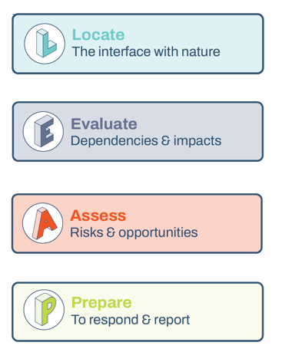
It includes LEAP, a step-by-step approach to assessing nature risks and opportunities
The LEAP approach was developed for companies and financial institutions across all sectors and sizes. It was refined based on extensive market feedback and pilot tested with over 240 organisations. Undertaking a LEAP assessment creates the information required for the TNFD’s recommended disclosures
Questions answered at each stage
Alignment to TNFD disclosure
Which parts of our business and value chain should we prioritise? Do they operate in sensitive locations?
What is the scale and scope of our dependencies and impacts on nature? Which are material?
Which corresponding risks and opportunities should be prioritised to address?
What risk management, strategy and resource allocation decisions should be made? How should progress be measured?
Strategy D
Strategy A, D Risk & impact management A, B Metrics & targets B
Strategy A, C, D Risk & impact management A, B, C Metrics & targets A, B
Governance A, B, C Strategy B, C Metrics & targets C
Review and repeat
Source: Guidance on the identification and assessment of nature-related issues: the LEAP approach

Slide 25
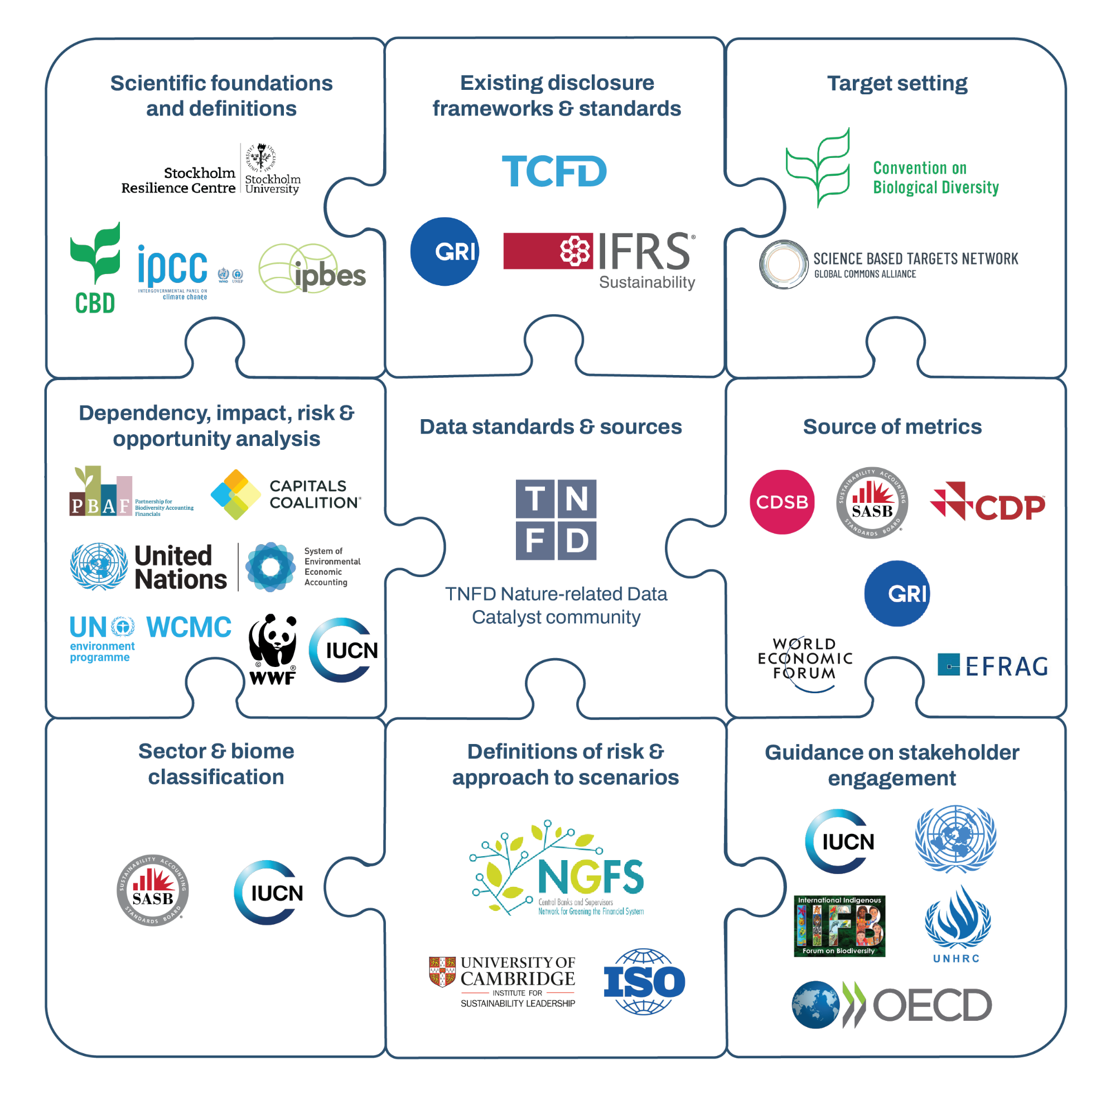
TNFD has been carefully designed to align with other key reporting frameworks and standards
TNFD has worked with 20 Knowledge Partners to ensure consistency with existing frameworks and standards:
Aligned to ISSB IFRS S1 General Requirements standard
Aligned to European Sustainability Reporting Standards (ESRS) and CSRD metrics (EFRAG correspondence mapping)
Aligned to GRI standards (GRI 101: Biodiversity)
Aligned to CDP metrics
All TCFD recommendations are incorporated into TNFD framework
Aligned to GBF Target 15
Source: Recommendations of the Taskforce on Nature-related Financial Disclosures

Slide 26
TNFD disclosures can also inform and complement several elements of transition planning
Framework adapted from Transition Plan Taskforce guidance:
Ambition
Action
Accountability
Foundations
Implementation strategy
Engagement strategy
Metrics & targets
Governance
Anchor transition plan on priority dependencies, impacts, risks and opportunities identified through the TNFD LEAP approach, including associated business units, value chain components and location
Leverage skills and knowledge developed through TNFD assessment and disclosure
Build out from climate transition plan
Use actions identified under Prepare stage of LEAP as starting point
Consult additional sources e.g. WEF Sector Actions Towards a Nature-Positive Future; World Business Council for Sustainable Development (WBCSD); Business for Nature
Build out from engagement undertaken for climate transition plan and TNFD disclosure (see TNFD guidance for engagement of affected stakeholders)
Include clients, suppliers, industry peers, public sector, communities, internal business as appropriate
Leverage TNFD LEAP assessment as baseline assessment of performance
Align targets and metrics with TNFD Core (sector) Metrics and Targets
Use periodic TNFD disclosures to report progress against targets
Leverage governance structure developed as part of TNFD disclosure, building out from climate
Assign joint accountability for TNFD and transition planning to ensure alignment
TNFD can support through
Source: The future of Nature in transition planning, TPT.

Slide 27
Adopters are encouraged to get started with the most relevant disclosures and build breadth and depth over time
Companies are registering with TNFD as an adopter to signal their intent to report in the future
Adoption means:
Learnings from early reporters
Start according to material scope and disclosures, using data available at the time. Apply materiality assessment
Most reporters start with a high-level materiality assessment to prioritise future work. Most reporters are choosing to report against only a handful of disclosures
Publish a report FY24/25 or FY25/26
Within LEAP, most reporters focus on impacts and dependencies (Locate and Evaluate) with few reporters quantifying financial risks (Assess)
Adoption does not require:
Most reports are combined with climate / TCFD. Reporters have found a high degree of consistency with their TCFD reports for the strategy and governance pillars. Some reports have included correspondence with other reporting frameworks e.g. GRI, CSRD
Conducting a LEAP assessment
Disclosing against all 14 TNFD recommended disclosures
Many businesses have expanded on existing stakeholder engagement strategies to include nature-related issues
Reporting on all of the recommended metrics
Most reports have detailed future scope of disclosures for next report iteration
Source: TNFD FAQs

Slide 28
About the authors
The Green Finance Institute (GFI) was established with support from the UK Government and the City of London in 2019 to partner on unlocking private sector finance to meet net zero and nature targets. The organisation works across multiple sectors, convening key stakeholders to identify barriers and develop solutions. Most recently, GFI CEO, Dr Rhian Mari Thomas OBE, acted as chair of the independent taskforce established to advise on the National Wealth Fund.
Specific to nature investment and environmental business resilience, the GFI hosts the Secretariat for the TNFD and the UK National Consultation Group of over 600 companies, funded by Defra. The broader nature team (GFI Hive) has advised and assessed on all three rounds of Defra’s Natural Environment Investment Readiness Funds (NEIRF) working with financial institutions, farmers, UK eNGOs and companies to support the UK to develop the supply, demand and enabling policy environment to unlock private sector investment in nature.
The GFI also leads work on GBF Target 19 with UNEP FI and UNDP Biofin, supporting signatories on developing models and markets that unlock private sector finance for nature restoration and conservation.
Chapter Zero, the Directors' Climate Forum, is a global centre of excellence for thought leadership working in partnership with the Climate Governance Initiative. We work with directors and chairs to integrate climate into business strategy.
Through expert-led curation, convening and community building, Chapter Zero's purpose is to equip and inspire non-executive directors with the tools, knowledge and capabilities needed to ensure that climate is a strategic priority in boardrooms. Our events and publications programme brings the latest thinking on climate to our members.
With 3,000 members, Chapter Zero is represented on the boards of over 80% of the FTSE 100 and 75% of the FTSE 250.
To join or explore our resources go to: www.chapterzero.org.uk

